Slide 1
L-Curve Criterion
Part 2

Slide 2
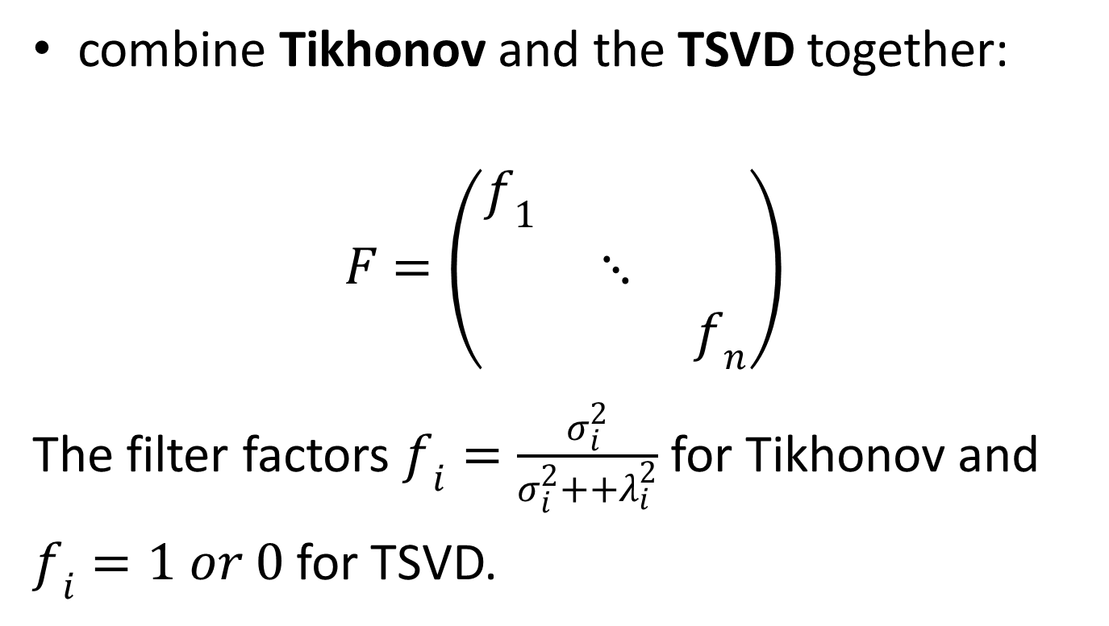
L-Curve Criterion
combine Tikhonov and the TSVD together:
$$F=\left(\begin{matrix}f_{1} & & \\ & ⋱ & \\ & & f_{n}\end{matrix}\right)$$
The filter factors $f_{i}=\frac{σ_{i}^{2}}{σ_{i}^{2}++λ_{i}^{2}}$ for Tikhonov and
$f_{i}=1 or 0$ for TSVD.

Slide 3
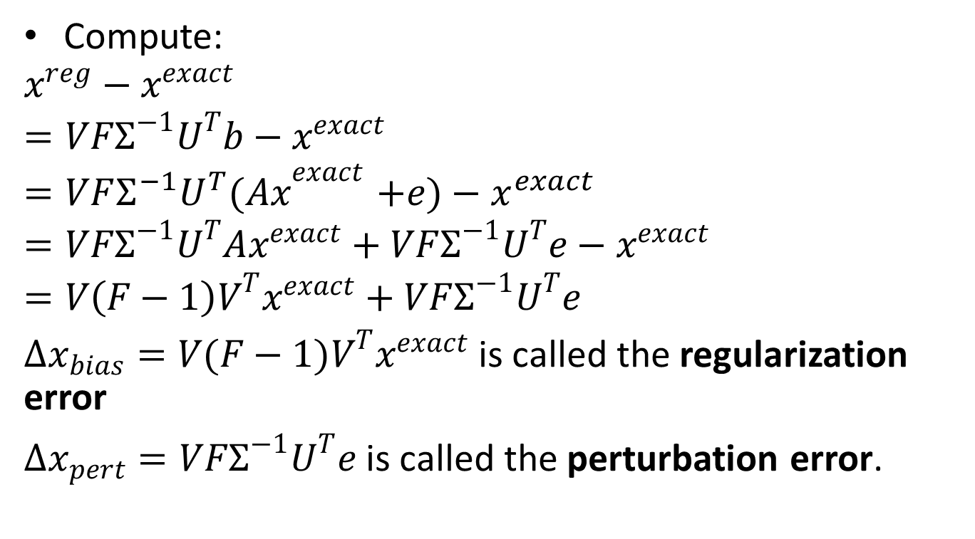
L-Curve Criterion
Compute:
$$x^{reg}−x^{exact}$$
$$=VFΣ^{−1}U^{T}b−x^{exact}$$
$${=VFΣ^{−1}U^{T}(Ax}^{exact}+e)−x^{exact}$$
$$=VFΣ^{−1}U^{T}Ax^{exact}+VFΣ^{−1}U^{T}e−x^{exact}$$
$$=V\left(F−1\right)V^{T}x^{exact}+VFΣ^{−1}U^{T}e$$
$Δx_{bias}=V(F−1)V^{T}x^{exact}$ is called the regularization error
$Δx_{pert}=VFΣ^{−1}U^{T}e$ is called the perturbation error.

Slide 4
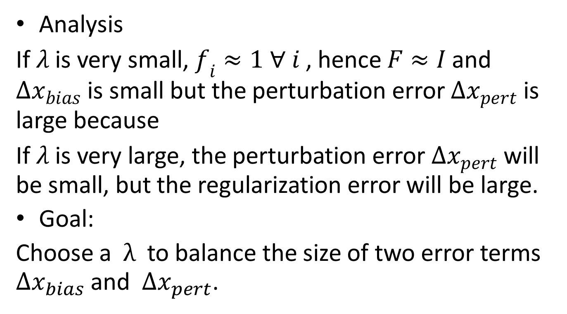
L-Curve Criterion
Analysis
If $λ$ is very small,$f_{i}≈1 ∀ i$ , hence $F≈I$ and $Δx_{bias}$ is small but the perturbation error $Δx_{pert}$ is large because
If $λ$ is very large, the perturbation error $Δx_{pert}$ will be small, but the regularization error will be large.
Goal:
Choose a $λ$ to balance the size of two error terms $Δx_{bias}$ and $Δx_{pert}$.

Slide 5
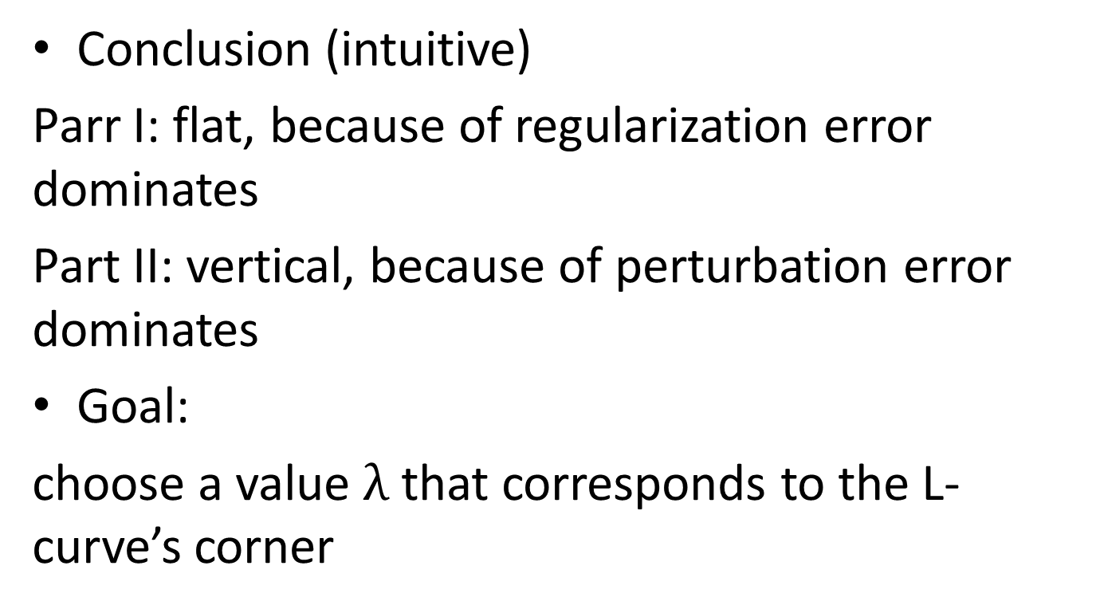
L-Curve Criterion
Conclusion (intuitive)
Parr I: flat, because of regularization error dominates
Part II: vertical, because of perturbation error dominates
Goal:
choose a value $λ$ that corresponds to the L-curve’s corner

Slide 6
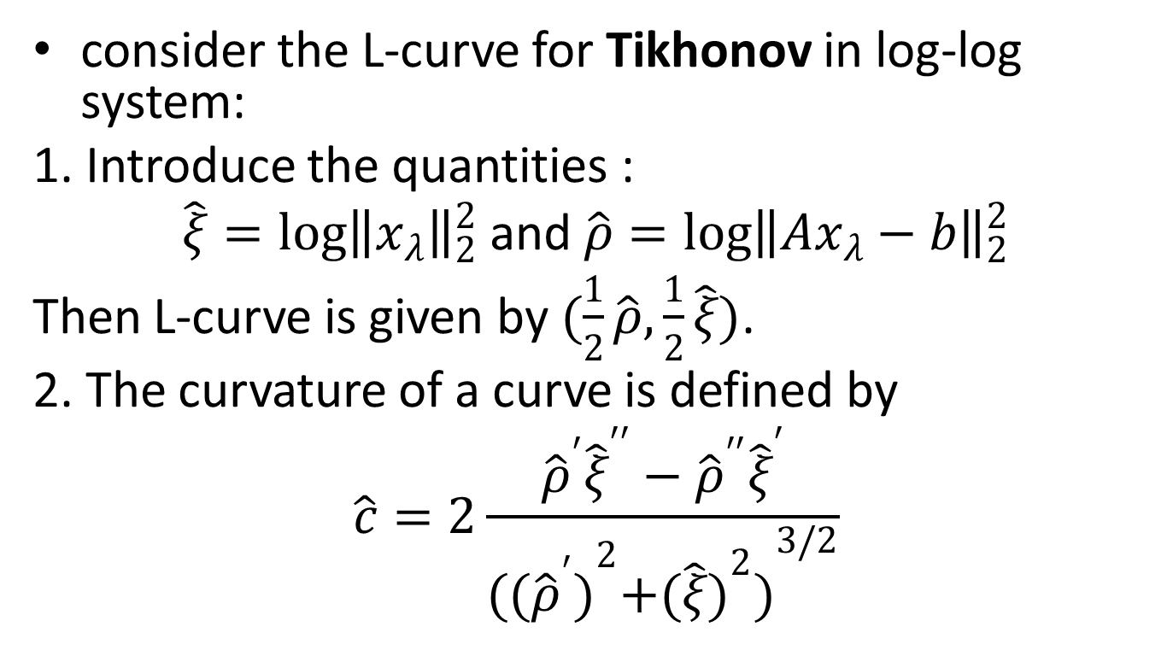
L-Curve Criterion
consider the L-curve for Tikhonov in log-log system:
1. Introduce the quantities :
$\hat{ξ}=\log{{\left\|x_{λ}\right\|}_{2}^{2}}$ and $\hat{ρ}=\log{{\left\|Ax_{λ}−b\right\|}_{2}^{2}}$
Then L-curve is given by $(\frac{1}{2}\hat{ρ}, \frac{1}{2}\hat{ξ})$.
2. The curvature of a curve is defined by
$$\hat{c}=2\frac{{\hat{ρ}}^{′}{\hat{ξ}}^{′′}−{\hat{ρ}}^{′′}{\hat{ξ}}^{′}}{({{({\hat{ρ}}^{′})}^{2}+{(\hat{ξ})}^{2})}^{3/2}}$$

Slide 7
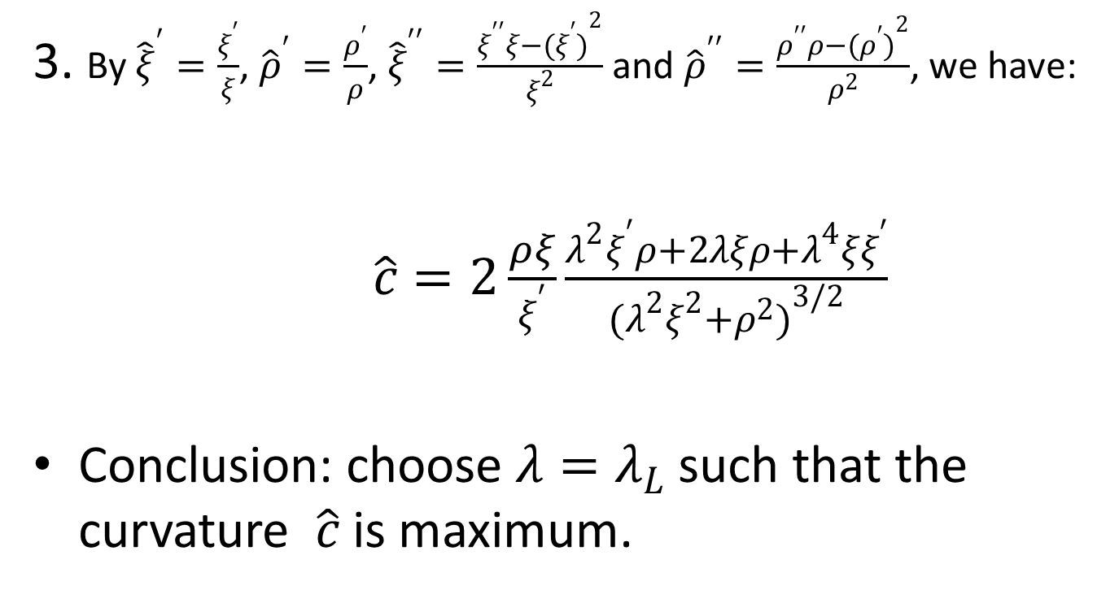
L-Curve Criterion
3. By ${\hat{ξ}}^{′}=\frac{ξ^{′}}{ξ}$, ${\hat{ρ}}^{′}=\frac{ρ^{′}}{ρ}$, ${\hat{ξ}}^{′′}=\frac{ξ^{′′}ξ−{(ξ^{′})}^{2}}{ξ^{2}}$ and ${\hat{ρ}}^{′′}=\frac{ρ^{′′}ρ−{(ρ^{′})}^{2}}{ρ^{2}}$, we have:
$\hat{c}=2\frac{ρξ}{ξ^{′}}\frac{λ^{2}ξ^{′}ρ+2λξρ+λ^{4}ξξ^{′}}{(λ^{2}ξ^{2}{+ρ^{2})}^{3/2}}$
Conclusion: choose $λ=λ_{L}$ such that the curvature $\hat{c}$ is maximum.

Slide 8
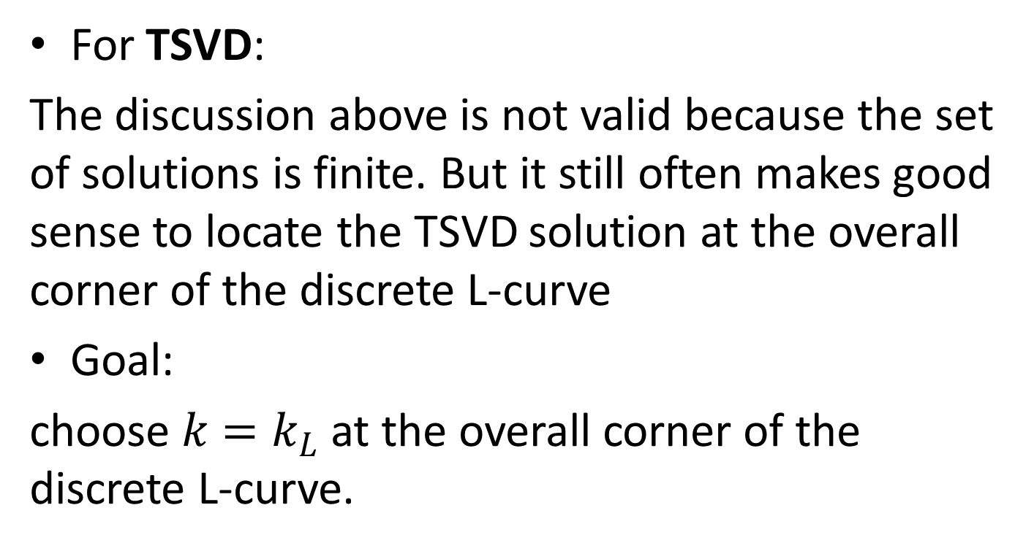
L-Curve Criterion
For TSVD:
The discussion above is not valid because the set of solutions is finite. But it still often makes good sense to locate the TSVD solution at the overall corner of the discrete L-curve
Goal:
choose $k=k_{L}$ at the overall corner of the discrete L-curve.

Slide 9
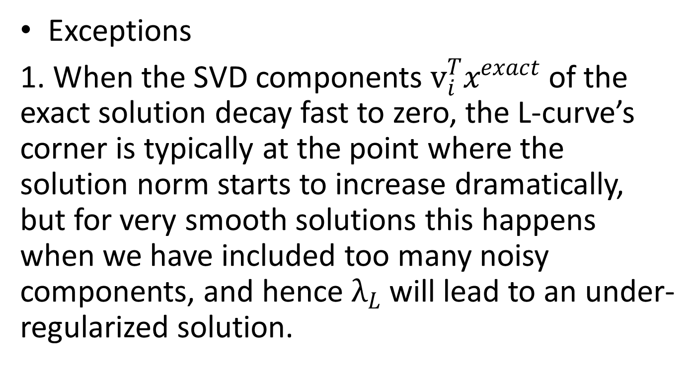
L-Curve Criterion
Exceptions
1. When the SVD components $v_{i}^{T}x^{exact}$ of the exact solution decay fast to zero, the L-curve’s corner is typically at the point where the solution norm starts to increase dramatically, but for very smooth solutions this happens when we have included too many noisy components, and hence $λ_{L}$ will lead to an under-regularized solution.

Slide 10

L-Curve Criterion
2. If we let the noise go to zero, then it has been shown that the regularization parameter $λ$ tends to diverge from the optimal one. Fortunately, there is a rare situation in practise.

